Slide 1
Canine mammary tumors
Sophie Agger, PhD student

Slide 2
Canine mammary tumors
Aims
Investigate the mutational landscape in canine mammary tumors/carcinomas
Coding regions
Constrained regions
Investigate the presence of circulating tumor DNA in bitches with mammary tumors
At the time of surgery
At relapse

Slide 3
Canine mammary tumors – mutational landscape
Tumors | #
Mammary carcinomas | 12
Benign | 2
Carcinosarcoma | 1
Osteosarcoma | 1
Squamous cell carcinoma | 1
Unknown SLU | 3
Unknown | 1
Total | 21
Malignant | 15
Carcinomas | #
Grade 1 | 4
Grade 2 | 3
Grade 3 | 5
Breed | #
Border Collie | 1
Boxer | 1
Cocker spaniel | 3
Danish-swedish farmdog | 1
Golden Retriever | 1
Jack Russel | 1
Japanese Spitz | 1
Kleiner Münsterländer | 2
Labrador | 2
Mix | 3
WHWT | 1
? | 4
Total | 21
Notes:
Mean age all: 10
Mean age malignant: 10.5

Slide 4
Canine mammary tumors – Circulating tumor DNA
ctDNA samples | #
Benign | 2
Carcinosarcoma | 1
Mammary carcinomas | 7
SCC | 1
Unknown | 1
Total | 12
Malignant | 9
Carcinomas | cfDNA
Grade 1 | 4
Grade 2 | 0
Grade 3 | 3
Breed | #
Boxer | 1
Cocker spaniel | 2
Danish-swedish farmdog | 1
Jack Russel | 1
Japanese Spitz | 1
Kleiner Münsterländer | 2
Labrador | 2
Mix | 1
? | 1
Total | 12

Slide 5
Flat-coated Retrievers – Aims
To investigate allele frequencies of SNPs already correlated to different phenotypes
To investigate if any SNPs are fixated in the Flat-coated Retrievers compared to other breeds
Hypotheses:
H₀: Flat-coated Retrievers has a unique genetic make-up due to selective breeding
H_{0a}: There are SNPs fixated in Flat-coated Retrievers compared to other breeds
H_{0b}: Flat-coated Retrievers will have a high frequency of phenoype related alleles in certain genes

Slide 6
WGS of 19 Flat-coated Retrievers
Mean coverage
CFA006591 | 23.83
CFA007614 | 23.59
CFA008068 | 24.08
CFA008193 | 24.31
CFA008402 | 21.49
CFA008433 | 24.78
CFA008455 | 25.17
CFA008473 | 23.70
CFA008491 | 22.92
CFA008537 | 23.37
CFA008582 | 21.94
CFA008731 | 22.87
CFA009017 | 23.18
CFA009192 | 20.98
CFA009655 | 21.28
CFA009786 | 23.69
CFA009911 | 22.10
CFA010674 | 23.59
CFA010766 | 25.21
All | 23.27
19 Swedish Flat-coated Retrievers
3 other dogs was sequenced in the same batch (referred to as 3dogs)
1 German shepherd
1 Cocker spaniel
1 Nova Scotia Duck Tolling Retriever
Phenotype | Number
Behavior | 8
Histiocytic Sarcoma | 6
Geriatric Control | 4
Cataract* | 1
Renal Dysplasia | 1
Total | 19
Mean coverage
Toller | 24.73
Cocker spaniel | 22.49
German shepherd | 21.85
All | 23.02
* This dog also had the phenotype ”Behavior”

Slide 7
Flat-coated Retrievers – Control groups
160 Swedish and American dogs
iDog
Breeds | #
Beagle | 20
Cavalier King Charles Spaniel | 20
German Shepherd | 20
Golden Retriever | 20
Labrador Retriever | 20
Standard Poodle | 20
Rottweiler | 20
West Highland White Terrier | 20
Total | 160
Breeds | #
Afghan_Hound | 1
Basenji | 1
Caucasian Ovcharka | 1
Chow chow | 1
German Shepherd | 10
Istrian Shorthaired Hound | 1
Jindo | 1
Kazakhstan Shepherd Dog | 1
Labrador Retriever | 1
Shar Pei | 1
Tibetan Mastiff | 10
Xoloitzcuintli | 1
Mix | 84
Total | 114
Notes:
160 dogs is an unpublished dataset that erik has from ??
iDog is a vcf file with 127 canines, where I have extracted c. familiaris only (so no wolves, jackals etc).
In addition the 2 datasets have been combined in the dataset ”both”

Slide 8
Flat-coated Retrievers – Alignment and Variant calling
Filters | SNP | INDELS
QD | < 2.0 | < 2.0
FS | > 60 | > 200
SOR | > 3.0 | > 10.0
MQ | < 40.0
QD | < 2.0
FS | > 60.0
MQRankSum | < -12.5
ReadPosRankSum | < -8.0 | < -20
Max maf | 0.99992
The NBISweden K9-WGS-Pipeline:
fastqc-0.11.5 - quality control
bwa-0.7.12 - alignment
samtools-1.5 – sorting and improving lookup
picard-2.10.6 – preprocessing
gatk-3.5 – preprocessing and variant calling
htslib-1.5 – compressing and indexing
vcftools-0.1.15 – file handling – subsetting etc.
bcftools 1.10 – file handling – subsetting etc.
plink 1.90b4.9 – statistics – F_{ST} and frequencies
Notes:
Samtools: Sorting by coordinates. Index cfreates a coordinated sorted index for fast lookup of specific areas.
Mark duplicates – picard: finds duplicate reads and tags them. Duplicates are basically mistakes and can be due to f.eks. PCR duplication or an amplification cluster being detected as 2 clusters. It also makes a metrics/summary file.
Baserecalibration - Gatk: Makes table of recalibration based on your input, it’s function is to find systematic errors by the sequencing machine, with machine learning it adjust the quality. It improves our variant calling later on, because we’re more sure about the quality of the data we’re basing it on. It has 2 steps, first it makes a model and then it applies it to the data. https://gatk.broadinstitute.org/hc/en-us/articles/360035890531-Base-Quality-Score-Recalibration-BQSR- make these graphs.

Slide 9
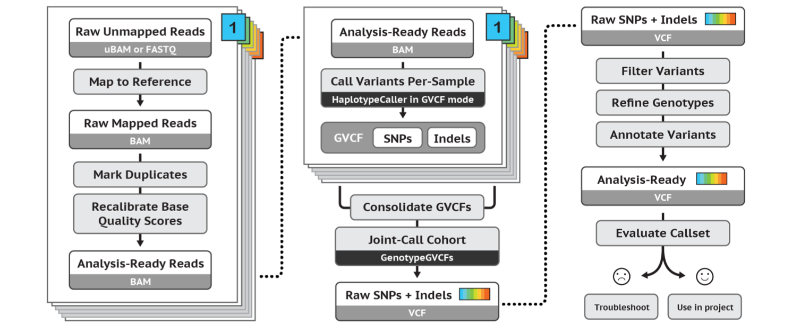
Flat-coated Retrievers – Pipeline
fastqc
bwa mem
samtools
picard
GATK
statistics
Notes:
Samtools: Sorting by coordinates. Index cfreates a coordinated sorted index for fast lookup of specific areas.
Mark duplicates – picard: finds duplicate reads and tags them. Duplicates are basically mistakes and can be due to f.eks. PCR duplication or an amplification cluster being detected as 2 clusters. It also makes a metrics/summary file.
Baserecalibration - Gatk: Makes table of recalibration based on your input, it’s function is to find systematic errors by the sequencing machine, with machine learning it adjust the quality. It improves our variant calling later on, because we’re more sure about the quality of the data we’re basing it on. It has 2 steps, first it makes a model and then it applies it to the data. https://gatk.broadinstitute.org/hc/en-us/articles/360035890531-Base-Quality-Score-Recalibration-BQSR- make these graphs.
After that several stat files are produced with samtools and picard
samtools flagstats: what passed and what failed
samtools stats collects statistics based on the bamfile and can be visualized
picard wgsmetrics: stats on coverage and performance of the sequencing.
Haplotypecaller: Calls the indels and SNPs simultaneously by local de-novo assembly, so it takes the regions made by the original alignment and reasembles the region with deBruin like graphs. And performs a pairwise alignment of the read data and it outpust the most likely genotype.
GenotypeGVCFs: Takes the output from haplotypecaller and makes a single file with the final genotype for all samples

Slide 10
Flat-coated Retrievers – Pipeline
fastqc
bwa mem
samtools
picard
GATK
statistics
Notes:
Haplotypecaller: Calls the indels and SNPs simultaneously by local de-novo assembly, so it takes the regions made by the original alignment and reasembles the region with deBruin like graphs. And performs a pairwise alignment of the read data and it outpust the most likely genotype.
GenotypeGVCFs: Takes the output from haplotypecaller and makes a single file with the final genotype for all samples

Slide 11
Flat-coated Retrievers – HaplotypeCaller
Notes:
Samtools: Sorting by coordinates. Index cfreates a coordinated sorted index for fast lookup of specific areas.
Mark duplicates – picard: finds duplicate reads and tags them. Duplicates are basically mistakes and can be due to f.eks. PCR duplication or an amplification cluster being detected as 2 clusters. It also makes a metrics/summary file.
Baserecalibration - Gatk: Makes table of recalibration based on your input, it’s function is to find systematic errors by the sequencing machine, with machine learning it adjust the quality. It improves our variant calling later on, because we’re more sure about the quality of the data we’re basing it on. It has 2 steps, first it makes a model and then it applies it to the data. https://gatk.broadinstitute.org/hc/en-us/articles/360035890531-Base-Quality-Score-Recalibration-BQSR- make these graphs.
After that several stat files are produced with samtools and picard
samtools flagstats: what passed and what failed
samtools stats collects statistics based on the bamfile and can be visualized
picard wgsmetrics: stats on coverage and performance of the sequencing.
Haplotypecaller: Calls the indels and SNPs simultaneously by local de-novo assembly, so it takes the regions made by the original alignment and reasembles the region with deBruin like graphs. And performs a pairwise alignment of the read data and it outpust the most likely genotype.
GenotypeGVCFs: Takes the output from haplotypecaller and makes a single file with the final genotype for all samples

Slide 12
Flat-coated Retrievers – HaplotypeCaller
Notes:
Samtools: Sorting by coordinates. Index cfreates a coordinated sorted index for fast lookup of specific areas.
Mark duplicates – picard: finds duplicate reads and tags them. Duplicates are basically mistakes and can be due to f.eks. PCR duplication or an amplification cluster being detected as 2 clusters. It also makes a metrics/summary file.
Baserecalibration - Gatk: Makes table of recalibration based on your input, it’s function is to find systematic errors by the sequencing machine, with machine learning it adjust the quality. It improves our variant calling later on, because we’re more sure about the quality of the data we’re basing it on. It has 2 steps, first it makes a model and then it applies it to the data. https://gatk.broadinstitute.org/hc/en-us/articles/360035890531-Base-Quality-Score-Recalibration-BQSR- make these graphs.
After that several stat files are produced with samtools and picard
samtools flagstats: what passed and what failed
samtools stats collects statistics based on the bamfile and can be visualized
picard wgsmetrics: stats on coverage and performance of the sequencing.
Haplotypecaller: Calls the indels and SNPs simultaneously by local de-novo assembly, so it takes the regions made by the original alignment and reasembles the region with deBruin like graphs. And performs a pairwise alignment of the read data and it outpust the most likely genotype.
GenotypeGVCFs: Takes the output from haplotypecaller and makes a single file with the final genotype for all samples. Med det her data, så tror vi på X

Slide 13
Flat-coated Retrievers – Pipeline
Notes:
With the produced variant-caller file, now it’s possible to apply

Slide 14
Flat-coated Retrievers – Alignment and Variant calling
QD: Quality of Depth
Normalized variant quality based on sequencing depth
Measure for how much we trust it.
FS: FisherStrand
The chance of an al. allele is seen on one strand versus the other.
Handles incorrect evaluation of evidence present based on strand bias
SOR: StrandOddsRatio
Other measure of strand bias
Handles exon ends better than FS
MQ: RMSMappingQuality
Estimates the overall mapping quality over all samples
MQRankSum
Compares mapping qualities of ref and alt. alleles – should be equal but we accept that the alt. allele has better score
ReadPosRankSum
Compares if the position of ref/alt. Alleles are the same between reads
End of reads are less certain
Filters | SNP | INDELS
QD | < 2.0 | < 2.0
FS | > 60.0 | > 200.0
SOR | > 3.0 | > 10.0
MQ | < 40.0
QD | < 2.0
FS | > 60.0
MQRankSum | < -12.5
ReadPosRankSum | < -8.0 | < -20
Max maf | 0.99992
Notes:
With the produced variant-caller file, now it’s possible to apply filters to only use the SNPs and indels we actually believe to be true.
QD: avoids inflation
ReadPosRankSum: If ref/alt. al are found close to ends or the same distribution.

Slide 15
Flat-coated Retrievers – Methods
F-statistics
In order to investigate whether any fixated SNPs were present, the fixation index (F_{ST}) for each SNP was calculated, and Z-transformed/standardized and 5 σ was set as significance level (max 4% of observations is more than 5 σ away from the median).
Minor allele frequencies
For SNPs already known to be associated with phenotypes the minor allele frequencies were calculated and reported.
Notes:
Skulle man sætte den til 4.5 istedet? Det vill svarer til at 0.05 ligger udenfor, såfremt at vi har en “infinite sample size” >= 100

Slide 16


Methods – Candidate genes (All data from 24/2/20)
Based on prior knowledge from human/mice/dogs
Genes related to cancer extracted from TCGA and the canine homolog found
TCGA
20 most commonly mutated genes in CMML in humans
20 most commonly mutated genes in cancer
20 most commonly mutated genes in germline
Disease
Genes mutated in histiocytic disease*
*Articles used
Boerkamp 2013
Liu et al . 2016
Hedan et at. 2011
Boerkamp 2014

Slide 17
Methods – Candidate genes (All data from 24/2/20)
Dogs
Genes associated with disease in FCR
Patella lux
Renal dysplasia
(Genes associated with disease in dogs)
(Genes associated with phenotypical variation in dogs)

Slide 18
Results – Genes related to germline cancer risk
No deleterious SNPs present in these genes
Notes:
15-20% dies of the disease

Slide 19
Results – Genes related to myeloid/macrophage/dendritic disease
Type | Disease | Gene | Location | A1 | A2 | MAF | A1|Het|A2
Missense | CMML | JAK2 | chr1:93143512 | A | G | 0.08 | 0 | 3 | 16
Deleterious | CMML | JAK2 | chr1:93423884 | G | C | 0.05 | 0 | 2 | 17
Deleterious low conf | CMML | IDH2 | chr3:53078015 | G | C | 0.00 | 0 | 0 | 19
Missense | CMML | SETBP1 | chr7:46044418 | C | T | 0.47 | 5 | 8 | 6
Deleterious low conf | CMML | NF1 | chr9:41486232 | T | C | 0.11 | 0 | 4 | 15
Missense | CMML | CSF3R | chr15:5828618 | G | A | 0.95 | 17 | 2 | 0
Missense | HS | PHYH | chr2:23191787 | C | G | 0.50 | 0 | 19| 0
Missense | HS | PHYH | chr2:23210149 | A | G | 0.08 | 0 | 3 | 16
Missense | HS | PHYH | chr2:23214889 | T | A | 0.50 | 0 | 19| 0
Missense | HS | C6 | chr4:68283166 | C | A | 0.29 | 1 | 9 | 9
Missense | HS | C6 | chr4:68296926 | T | A | 0.18 | 1 | 5 | 13
Missense | HS | C6 | chr4:68298582 | T | C | 0.13 | 0 | 5 | 14
Missense | HS | VCAM1 | chr6:49348887 | T | C | 0.47 | 4 | 10 | 5
Missense | HS | SPIC | chr15:40452490 | A | G | 0.00 | 0 | 19 | 0
Histiocytic disease:
8 missense mutations found
Chronic myelomonocytic leukemia
6 missense mutations found
3 Deleterious mutations found
Notes:
skriv navne på Highlight
Publikationer ud af dataen
Hvilke som mut review generelt.
Andet review?
cfDNA scoping review.

Slide 20
Results – Genes related to miscellaneous phenotypes
Patella luxation
No deleterious SNPs
Renal dysplasia
4 deleterious SNPs
ABCB1
386 SNPs
49 non-intron SNPs
2 missense mutations – tolerated
ABCB1‐1Δ not present (collie mutation)
PRA
TTC8 – 1 missense, but tolerated – MAF: 0.31
Notes:
Check RD gener hos RD hund

Slide 21
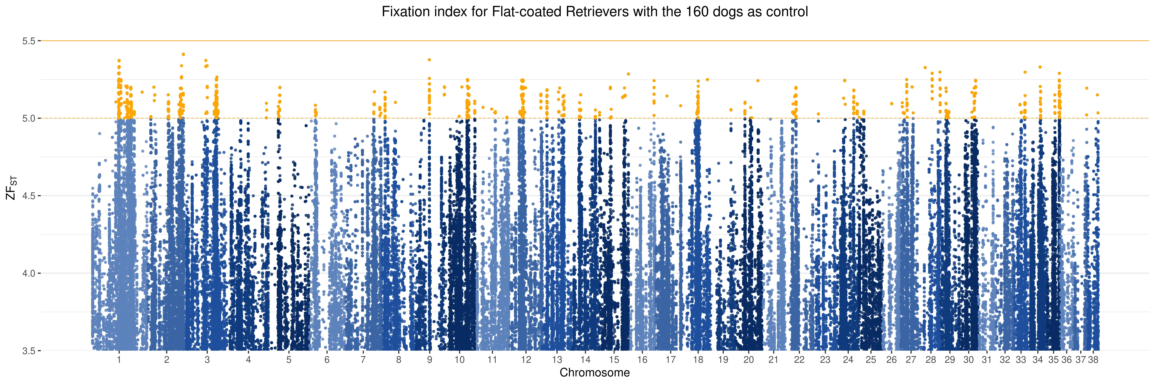
Results – F_{ST} – 160 dogs
Notes:
15-20% dies of the disease

Slide 22
Results – Z(F_{ST}) ≥ 5 –160 dogs
2 missense variants with F_{ST} ≥ 5, but tolerated according to SIFT
FAM83H
ADD1
Type | No | %
Intergenic variant | 930 | 55%
Intron variant | 432 | 26%
Intron variant/non-coding transcript variant | 133 | 8%
Downstream gene variant | 118 | 7%
Upstream gene variant | 74 | 4%
Non-coding transcript exon variant | 2 | 0%
Missense variant | 2 | 0%
Synonymous variant | 1 | 0%
Total | 1692 | 100%
Notes:
15-20% dies of the disease

Slide 23
Assessment
2. Assesment
01/08/20-31/10/20
3. Assesment
01/01/21-30/06/21

Slide 24
Flat-coated Retrievers – Alignment and Variant calling
The NBISweden K9-WGS-Pipeline:
fastqc-0.11.5
Evaluation of data/read quality
bwa-0.7.12
bwa mem for aligning to ref
samtools-1.5
Sorting of alignments and indexing
Stats
gatk-3.5
Recalibration
picard-2.10.6
Marking of duplicates
htslib-1.5
Filters | SNP | INDELS
QD | < 2.0 | < 2.0
FS | > 60.0 | > 200.0
SOR | > 3.0 | > 10.0
MQ | < 40.0
QD | < 2.0
FS | > 60.0
MQRankSum | < -12.5
ReadPosRankSum | < -8.0 | < -20
Max maf | 0.99992
Notes:
Samtools: Sorting by coordinates. Index cfreates a coordinated sorted index for fast lookup of specific areas.
Mark duplicates – picard: finds duplicate reads and tags them. Duplicates are basically mistakes and can be due to f.eks. PCR duplication or an amplification cluster being detected as 2 clusters. It also makes a metrics/summary file.
Baserecalibration - Gatk: Makes table of recalibration based on your input, it’s function is to find systematic errors by the sequencing machine, with machine learning it adjust the quality. It improves our variant calling later on, because we’re more sure about the quality of the data we’re basing it on. It has 2 steps, first it makes a model and then it applies it to the data. https://gatk.broadinstitute.org/hc/en-us/articles/360035890531-Base-Quality-Score-Recalibration-BQSR- make these graphs.

